Slide 1
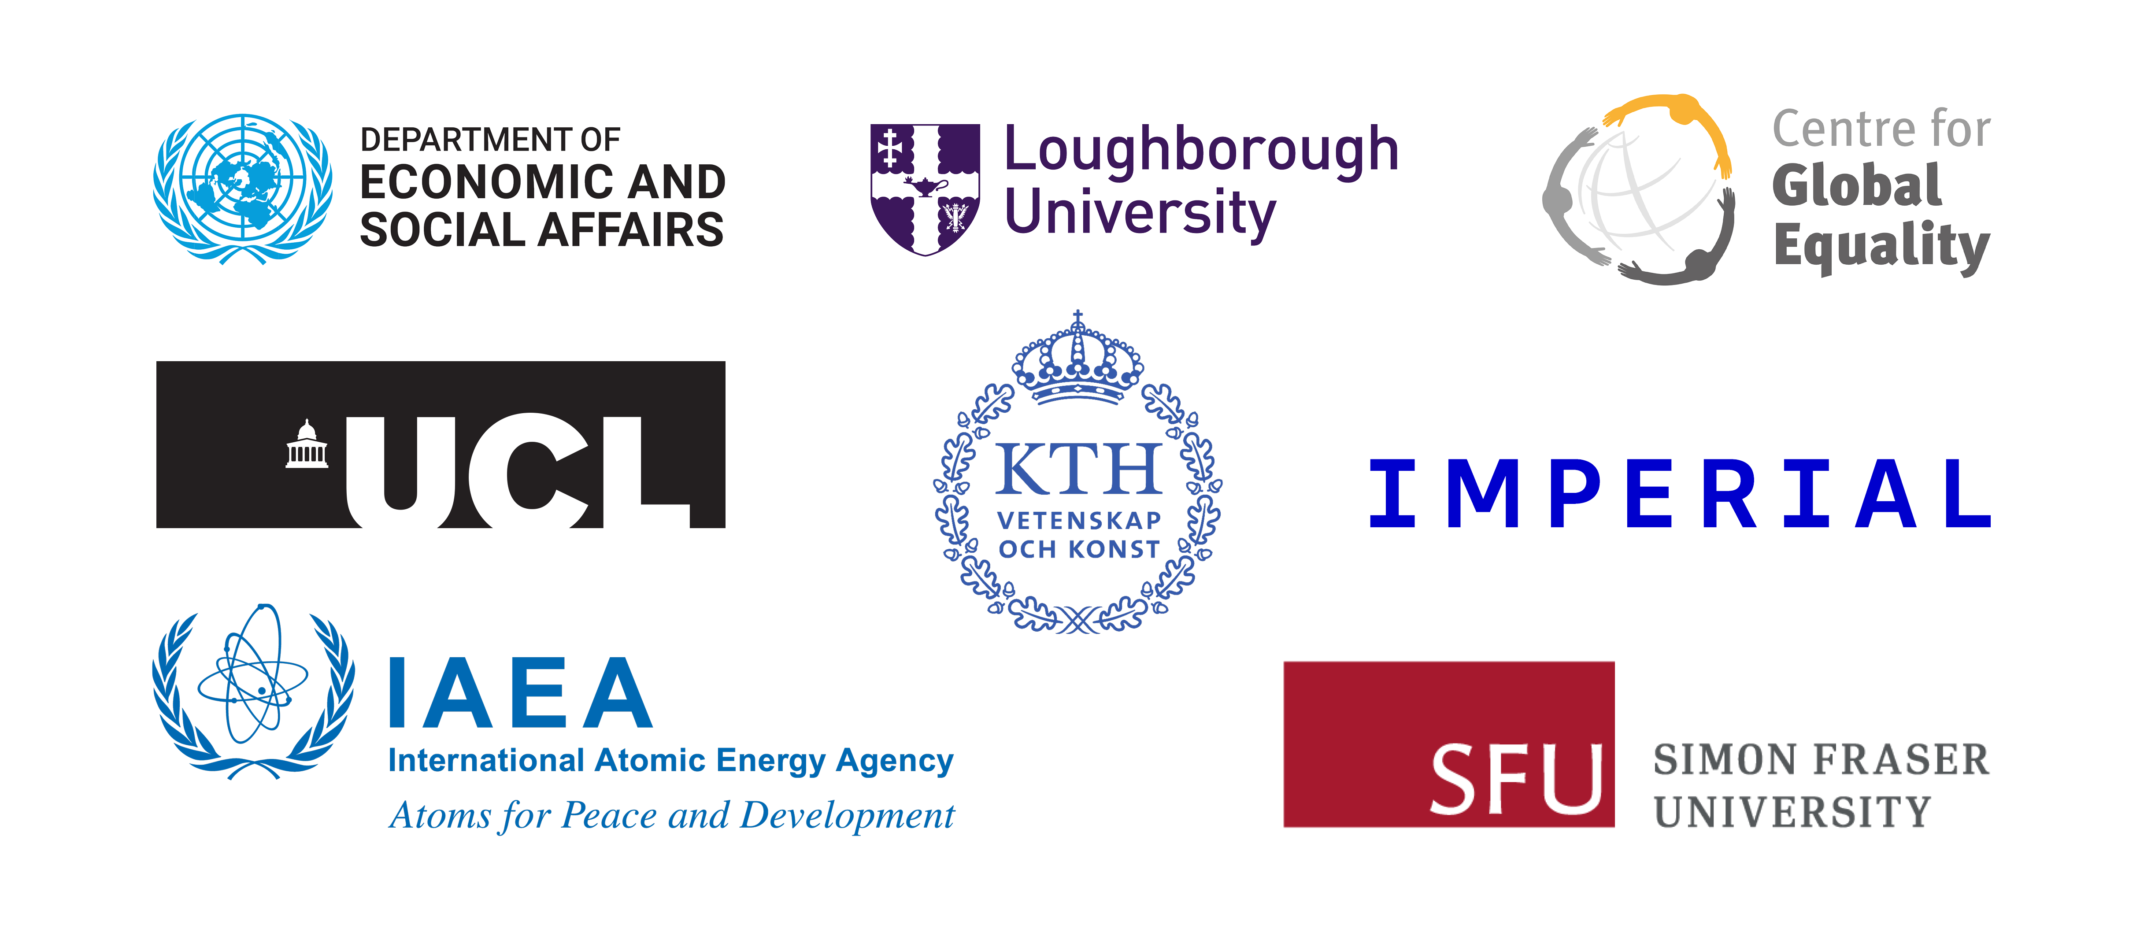
Energy system modelling using OSeMOSYS
LECTURE 1
ENERGY SYSTEM MODELLING AND ENERGY PLANNING

Slide 2
Learning Outcomes
By the end of this lecture, you will be able to:
ILO1: Learn why energy planning is important and the role of energy system modelling for energy planning
ILO2: Learn about the concept of SDGs, the strong interlinkages between them, and the global climate agendas
ILO3: Understand some introductory concepts about energy system models
ILO4: Get an overview of this course in Energy System Modelling using OSeMOSYS
2

Slide 3

1.1 Why is energy planning important?
1.1.1 Why plan an energy system?
Energy security
Environmental sustainability
Affordability and accessibility
Socio-economic development
Energy resilience
Source: (Pfenninger et al., 2014)
3
Notes:
Energy has become more crucial than ever for humanity, touching all aspects of life—from something as simple as turning on a light bulb to powering heavy industries like steel and cement production. In this context, energy planning is essential to ensure an adequate and continuous energy supply, anytime and anywhere. Five key points can be highlighted:
Energy security refers to a reliable and uninterrupted energy supply. It includes energy sovereignty, which reduces reliance on external sources by maximizing domestic resources.
Environmental sustainability addresses issues ranging from local air and water pollution to, most importantly, combating climate change and global warming.
Affordability and accessibility are vital, as energy must be financially feasible and available to all sectors of society. This also includes extending energy access to underserved populations such as women, people with disabilities, ethnic minorities, and other vulnerable communities.
Socio-economic development involves bringing new technologies to market, building competitive industries, and delivering sustainable energy to regions dependent on energy imports. It creates economic opportunities by generating jobs, reducing poverty, promoting gender equality, and fostering economic growth.
Energy resilience is critical for protecting systems against potential disruptions—such as natural disasters or geopolitical conflicts—enabling nations to recover quickly and maintain energy supplies. It also involves diversifying energy sources to ensure stability when one source is compromised.

Slide 4

1.1 Why is energy planning important?
1.1.2 What is energy planning?
Energy planning is the act of assessing the ability of a regional system to provide dependable energy services under constantly changing conditions.
Advanced analytical methods and tools to make better decisions when faced with complex decisions.
Identifies the most cost-effective way of delivering energy to the final consumer.
Main barriers are lack of adequate data and shortage of skilled human resources.
Thus, investment decisions are often based on ill-informed policy targets and a need for ad-hoc stop-gap measures.
(Rexazin, M., image)
Source: (The World Bank 2017)
4
Notes:
Energy planning is the act of assessing the ability of a regional system to provide dependable energy services under constantly changing conditions. For example, variables such as the cost of materials and fuels, investment costs in technologies, demand levels, and distribution may all change.
It is important to recognize that energy includes all types of energy carriers, from domestic production to end-use consumption. This encompasses not only electricity but also energy demands for cooking, transportation, and industrial heat.
Drawing on the field of operations research, energy planning applies advanced analytical methods and tools to make better decisions when faced with complex decisions. This process must be done iteratively due to the fast transformations that can take place over a very limited period.
Energy planning models allow for the most cost-effective way of delivering energy to the final consumer. Of course, the most cost-effective way of providing energy changes in different parts of the world. However, quantitative energy modelling offers a promising tool to better make decisions under uncertainty.
The main barriers for developing countries are the lack of adequate data and a shortage of skilled human resources to perform the analysis. Therefore, investment decisions are often based on ill-informed policy targets and the need for ad-hoc stop-gap measures. These measures, therefore, tend to focus on cheap and quick-to-build technologies, which can result in higher environmental and operating costs. Given that such actions serve the supply shortfalls of already-connected consumers, increasing access is rarely part of the strategy.

Slide 5
1.1 Why is energy planning important?
1.1.3 What is the process of energy planning?
Scenario design and data gathering (stakeholder engagement)
Policy question (problem statement)
Quantitative / Qualitative assessment (energy modelling)
.
Result analysis (stakeholder engagement)
Energy policy making (action measures)
01
02
03
04
05
Source: Adapted from (Carvajal et al., 2022)
5
Notes:
The energy planning process begins by identifying a clear policy question or problem statement, which sets the stage for addressing key energy challenges like security, sustainability, or affordability. Next, in scenario design and data gathering, different energy scenarios are developed, and comprehensive data is collected through active stakeholder engagement. This ensures the energy plans reflect diverse needs and are based on realistic assumptions.
Following this, quantitative and qualitative assessments using energy modelling are conducted to analyze the impacts of various scenarios. The results are then analyzed and discussed with stakeholders in the result analysis phase, ensuring alignment with their needs and goals. Importantly, this process is flexible, with possible loops between the scenario design, data gathering, and result analysis stages. If new insights or data emerge during the analysis, the process can revisit earlier steps to refine scenarios and improve the model's accuracy. Finally, the process concludes with energy policy making, where actionable measures are developed to address the original policy question.

Slide 6
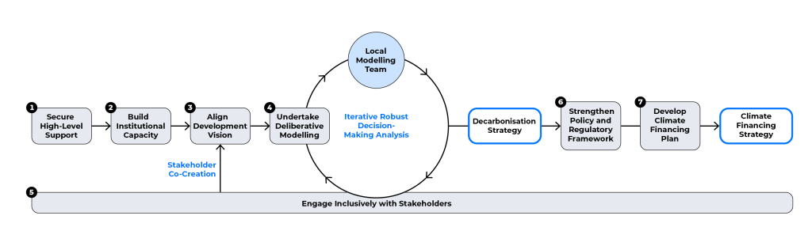
1.1 Why is energy planning important?
1.1.4 Data-to-Deal Framework
Source: (CCG, 2024)
More info can be found at https://climatecompatiblegrowth.com/data-to-deal/
6
Notes:
The ‘Data-to-Deal’ (D2D) framework is inspired by Costa Rica's successful approach, where the country secured over US$2.4 billion in climate finance through a structured process of technical analysis and stakeholder engagement. This initiative, which cost approximately US$200,000 and spanned three years, demonstrates the power of systematic planning. The term ‘Data-to-Deal’ refers to a comprehensive pipeline that includes data collection, system modelling, and development planning, leading to national financing strategies and project finance arrangements. The entire process is underpinned by strong stakeholder involvement. The D2D pipeline encompasses seven key elements:
Politics: Garnering high-level support for decarbonisation and inclusive growth.
Preparation: Establishing the foundations of institutional capacity.
Vision: Aligning climate change objectives with broader development goals.
Modelling: Conducting deliberative quantification of scenarios.
Consultation: Engaging inclusively across stakeholder groups.
Operationalisation: Enhancing the policy and regulatory framework.
Finance: Developing investment plans and financing strategies.
For more information, visit https://climatecompatiblegrowth.com/data-to-deal/

Slide 7

1.1 Why is energy planning important?
1.1.5 Benefits of energy systems models
Quantified models of complex systems help decision makers in numerous ways.
Enable analysts to compare different system configurations without the costs of building them.
Mitigation of uncertainty.
Facilitate the design of systems which account for local resources, demands, and constraints.
Ensure minimization of consumer electricity bills.
Development of scenarios for non-partisan political commitment.
Minor system improvements can have disproportionally high positive economic and environmental returns.
(Segerst, image)
Source: (The World Bank 2017)
7
Notes:
Quantified models of complex systems can help decision makers in multiple ways. From a technical perspective, they allow analysts to compare different system configurations without incurring the upfront costs of building them. This enables the mitigation of uncertainty.
From a practical perspective, they facilitate the design of systems in a way that accounts for local resources, demands, and constraints that are placed upon real life electricity systems. This enables minimization of consumer electricity bills by allowing governmental institutions to structure tariffs optimally.
The development of scenarios can serve as an effective communication tool for non-partisan political commitment, which will help both to garner and mobilize private sector support, and to solicit agreement from society at large.
For developing countries, the impact of even minor system improvements often can have disproportionally high positive economic and environmental returns.

Slide 8
Lecture 1.1 References
1. Carvajal, P. E., Miketa, A., Goussous, N., & Fulcheri, P. (2022). Best Practice in Government Use and Development of Long-Term Energy Transition Scenarios. In Energies (Vol. 15, Issue 6). MDPI. https://doi.org/10.3390/en15062180
2. CCG. (2024). DATA-TO-DEAL (D2D): AN EMERGING AND EFFECTIVE APPROACH TO FINANCING THE CLIMATE TRANSITION. https://climatecompatiblegrowth.com/data-to-deal/
3. Howells M, Rogner H.H, Mentis D, Broad O. SEAR Energy Access and Electricity Planning Special Feature, The World Bank, 2017.
4. Pfenninger, S., Hawkes, A., & Keirstead, J. (2014). Energy systems modeling for twenty-first century energy challenges. Renewable and Sustainable Energy Reviews, 33, 74–86. https://doi.org/10.1016/j.rser.2014.02.003
8

Slide 9

1.2 SDGs and Climate Action Agenda
1.2.1 Overview of the SDGs
(Kim et al. (2018), image, licensed under CC BY 4.0)
9
Notes:
The sustainable development goals (or S.D.Gs for short) are a set of universal goals for all countries focused on ending poverty, improving quality of life, and protecting the environment. These goals were agreed upon in 2015, with 2030 as the target year for achieving them. The sustainable development goals aim to tackle multiple issues, with goals based around poverty, health gender equality, environmental protection, climate action, justice, and more. The goals are designed to be thought of together, rather than in isolation, and there are many links between different goals, which we will discuss in later slides. We will also look at global progress and see that factoring these goals into national planning and modelling is essential.

Slide 10

1.2 SDGs and Climate Action Agenda
1.2.2 SDG7
SDG7 Targets for 2030:
Universal access to affordable, reliable, and modern energy services.
Substantial increase in the share of renewables.
Doubled global rate of improvement in energy efficiency.
Improved access to clean energy research and technology to promote investment.
Expanded and improved modern energy infrastructure in developing countries.
(UN Women Europe and Central Asia, image, licensed under CC BY NC 2.0)
Source: (IEA, IRENA, UNSD, World Bank, WHO (2020))
10
Notes:
Sustainable Development Goal 7 (or S.D.G. 7 for short) specifically focuses on the energy sector. The first target set in S.D.G. 7 is universal access to affordable, reliable, and modern energy services. This includes access to electricity and access to clean cooking. Secondly, S.D.G. 7 calls for a substantial increase in the share of renewables in order to reduce greenhouse gas emissions and increase the sustainability of energy supply. Another important element of improving the sustainability of the energy sector is energy efficiency, so S.D.G. 7 targets a doubling of the rate of global improvement in energy efficiency. Additionally, this S.D.G. targets improved cooperation to increase access to clean energy research and technology and to promote investment, as well as expanded and improved modern energy infrastructure in developing countries. All of these targets are set in pursuit of reduced poverty and greater sustainability. Although S.D.G. 7 explicitly focuses on the energy sector, we will see later that all of the goals are strongly interlinked and energy is important for multiple other goals.

Slide 11
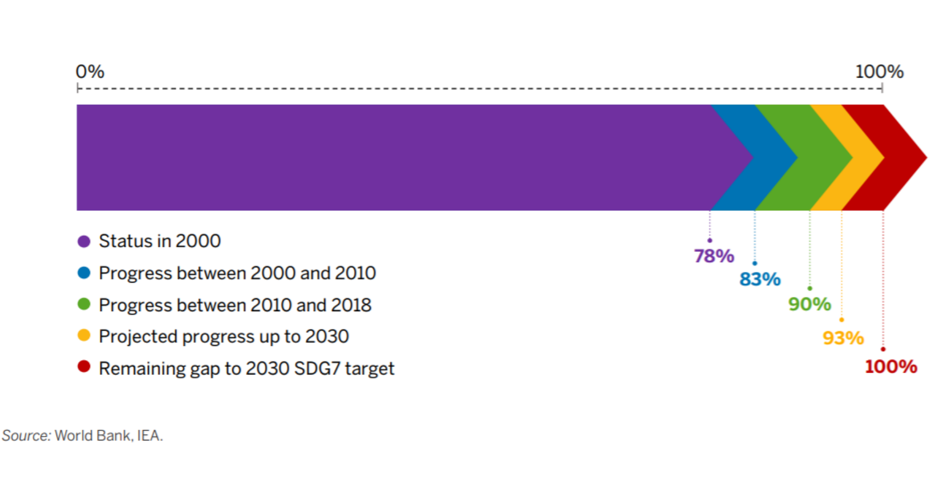
1.2 SDGs and Climate Action Agenda
1.2.3 Progress on SDG7: Access to Electricity & Clean Cooking
90% of the population had electricity access in 2018, up from 83% in 2010.
However, the annual electrification rate is not high enough to achieve universal access by 2030.
63% of the population had access to clean cooking in 2018, up from 56% in 2010.
Annual progress is currently less than 1/3 of what is needed to achieve universal clean cooking access by 2030.
Global electricity access
(IEA, IRENA, UNSD, World Bank, WHO (2020), image, licensed under CC BY NC 3.0 IGO)
Source: (IEA, IRENA, UNSD, World Bank, WHO (2020))
11
Notes:
According to the Tracking S.D.G. 7 report, there has been progress in improving access to both electricity and clean cooking in recent years. This report states that electricity access increased from 83% in 2010 to 90% in 2018, while clean cooking access increased from 56% to 63%. However, the report's analysis also finds that current rates of progress are insufficient to meet the targets set by S.D.G. 7 by 2030. There are also key regions where progress has been slower. For example, the population without access to electricity is concentrated in Sub-Saharan Africa, which has an overall access rate of 47%. Energy modelling tools can be used to support policymaking to increase access to both electricity and clean cooking in several ways. This includes the use of geospatial electrification modelling to assess which access solutions are most economical for different regions. It also includes capacity expansion planning to assess how supply can be increased with minimized economic and environmental impacts.

Slide 12
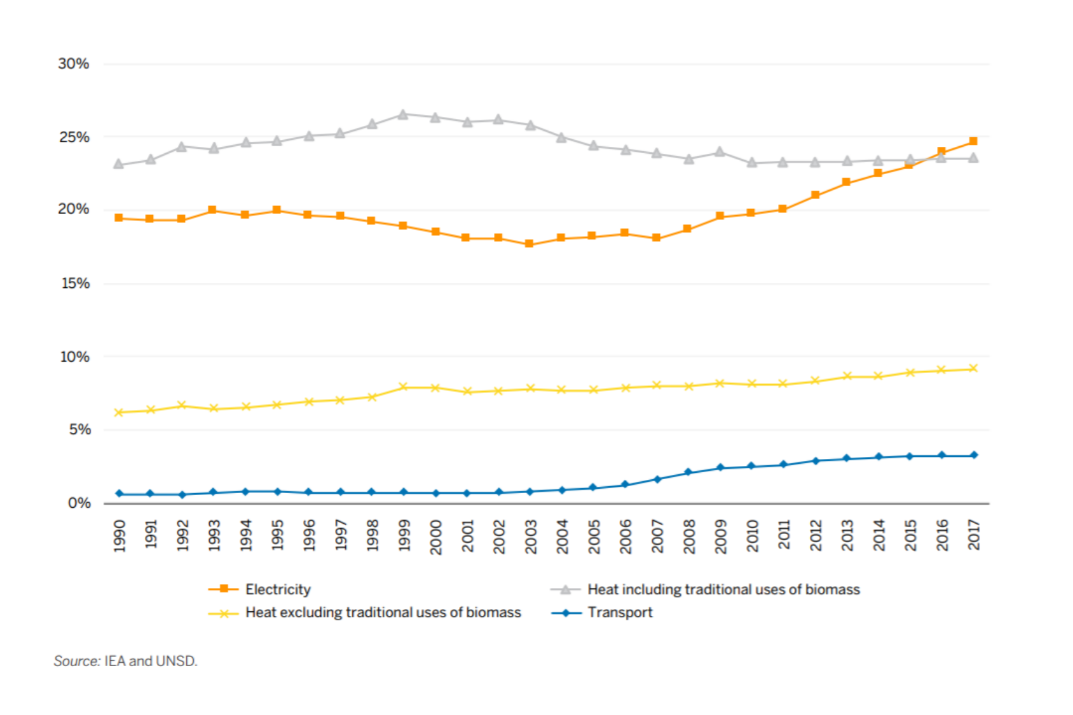
1.2 SDGs and Climate Action Agenda
1.2.4 Progress on SDG7: Renewable Energy & Energy Efficiency
(IEA, IRENA, UNSD, World Bank, WHO (2020), image, licensed under CC BY NC 3.0 IGO)
12
Notes:
This graph shows the share of electricity, heat, and transport demands met by renewables globally. We can see that there has been some progress in increasing the share of renewables in the electricity and transport sectors, and also in the heat sector when traditional biomass use is excluded. Overall, according to the SDG 7 Tracking Report, the share of renewable energy in Total Final Energy Consumption reached 17.3 percent in 2017, up from 16.3 percent in 2010. The most progress has been made in the power sector, which is largely attributed to the growth in solar PV and wind energy. However, to achieve SDG 7, more progress is needed, with most scenarios requiring the decarbonization of end use sectors. This includes the electrification of transport and heat, where there has been relatively slow progress. ​
On energy efficiency, global reductions in primary energy intensity have unfortunately slowed in recent years, despite progress still being greater than in the period before 2010. The SDG 7 Tracking Report analysis shows that the transport sector has seen an increase in energy intensity improvement since 2010, while other sectors have seen a decrease. There are also differences by region, with Sub-Saharan Africa having the highest energy intensity, while Latin America and the Caribbean have the lowest. If the SDG 7 target of doubling the rate of global improvement in energy efficiency by 2030 is to be met, energy efficiency measures must be prioritized in policymaking and investment planning.​

Slide 13
1.2 SDGs and Climate Action Agenda
1.2.5 Links between SDGs?
The SDGs are highly interlinked, with synergies and trade-offs between different targets.
Out of 169 targets in total, at least 113 are identified as requiring actions to change energy systems.
Energy planning must therefore go beyond SDG7 and consider linkages with other systems, goals, and policy areas.
Integrated assessments and policymaking will be essential to maximizing synergies between targets and realizing all of the SDGs.
Source: (Nerini, Tomei and To et al. (2018))
13
Notes:
The sustainable development goals are designed to be viewed as a group and many studies have found a large number of synergies and trade-offs between different targets. It is important that these interactions are understood so that policymakers can make plans to maximize synergies and minimize trade-offs. Modelling tools have a key role in understanding these interactions, as they can be used to develop cross-sectoral scenarios and explore their impacts. There are many, often complex, links between systems and Sustainable Development Goals.
As an example, let's think about the links between the energy system and S.D.G. targets. Nerini et al. (2018) found that at least 113 of the 169 S.D.G. targets require changes in energy systems. Examples include targets in S.D.G. 13, which focus on climate change action, requiring decarbonization of the energy system, and targets in S.D.G. 1, which focus on ending poverty, requiring improved energy infrastructure to increase modern energy access. There are many more synergies and trade-offs that we do not have time to explore in more detail; however, it is clear that policymakers need to understand these interactions in order to support progress towards the S.D.Gs. Nerini et al. highlight that we cannot think in silos and must use integrated planning approaches with a long-term perspective. Energy modelling tools are a key enabler of such approaches.

Slide 14
Lecture 1.2 References
Kim, R.C. Can Creating Shared Value (CSV) and the United Nations Sustainable Development Goals (UN SDGs) Collaborate for a Better World? Insights from East Asia. Sustainability 2018, 10, 4128. https://doi.org/10.3390/su10114128
IEA, IRENA, UNSD, World Bank, WHO. 2020. Tracking SDG 7: The Energy Progress Report. World Bank, Washington DC. © World Bank. License: Creative Commons Attribution—NonCommercial 3.0 IGO (CC BY-NC 3.0 IGO).
Fuso Nerini, F., Tomei, J., To, L.S. et al. Mapping synergies and trade-offs between energy and the Sustainable Development Goals. Nat Energy 3, 10–15 (2018). https://doi.org/10.1038/s41560-017-0036-5
14
14

Slide 15
1.3 Basic concepts in energy system modelling
1.3.1 Energy system models
Energy system models
Optimization models
Normative Scenarios
Simulation models
Analytical evaluation
Quantitative reasoning
Qualitative assessment
Power sector models
Forecasting Predictions
Operational dynamics - Dispatch
Power market
Source: Adapted from (Pfenninger et al., 2014)
15
Notes:
An energy system model is a mathematical representation of an energy system used to analyze the generation, transformation, distribution, and consumption of energy in various forms, such as electricity, heat, and fuel. These models help policymakers, researchers, and industry stakeholders understand the behavior of energy systems and assist in decision-making related to energy planning, technology deployment, and policy development. These models can be categorized into four main groups, each serving a specific purpose in analyzing and managing energy systems:
Optimization models: These models focus on determining the best outcomes or solutions under given constraints, such as minimizing costs or maximizing system efficiency. They are typically used to develop Normative Scenarios, which outline what should happen based on desired future goals or outcomes.
Simulation models: These models are designed to imitate the behavior of energy systems under different conditions. Their primary use is in Predictive Forecasting, where they help anticipate future system behavior based on historical data and projected trends.
Power sector models: Focused specifically on the electricity sector, these models simulate the operational dynamics, such as how electricity is dispatched and traded in the power market. They are critical for understanding short-term operational issues, including dispatch optimization and market dynamics.
Qualitative assessment: These are more interpretive models used for analytical evaluation and quantitative reasoning. They often complement the other models by offering insights that go beyond numbers, addressing factors like policy implications, social acceptance, or other qualitative considerations.
It is important to stress that this is a proposal for how to classify energy system models; it is non-exhaustive, and there are alternative ways to categorize these models.

Slide 16
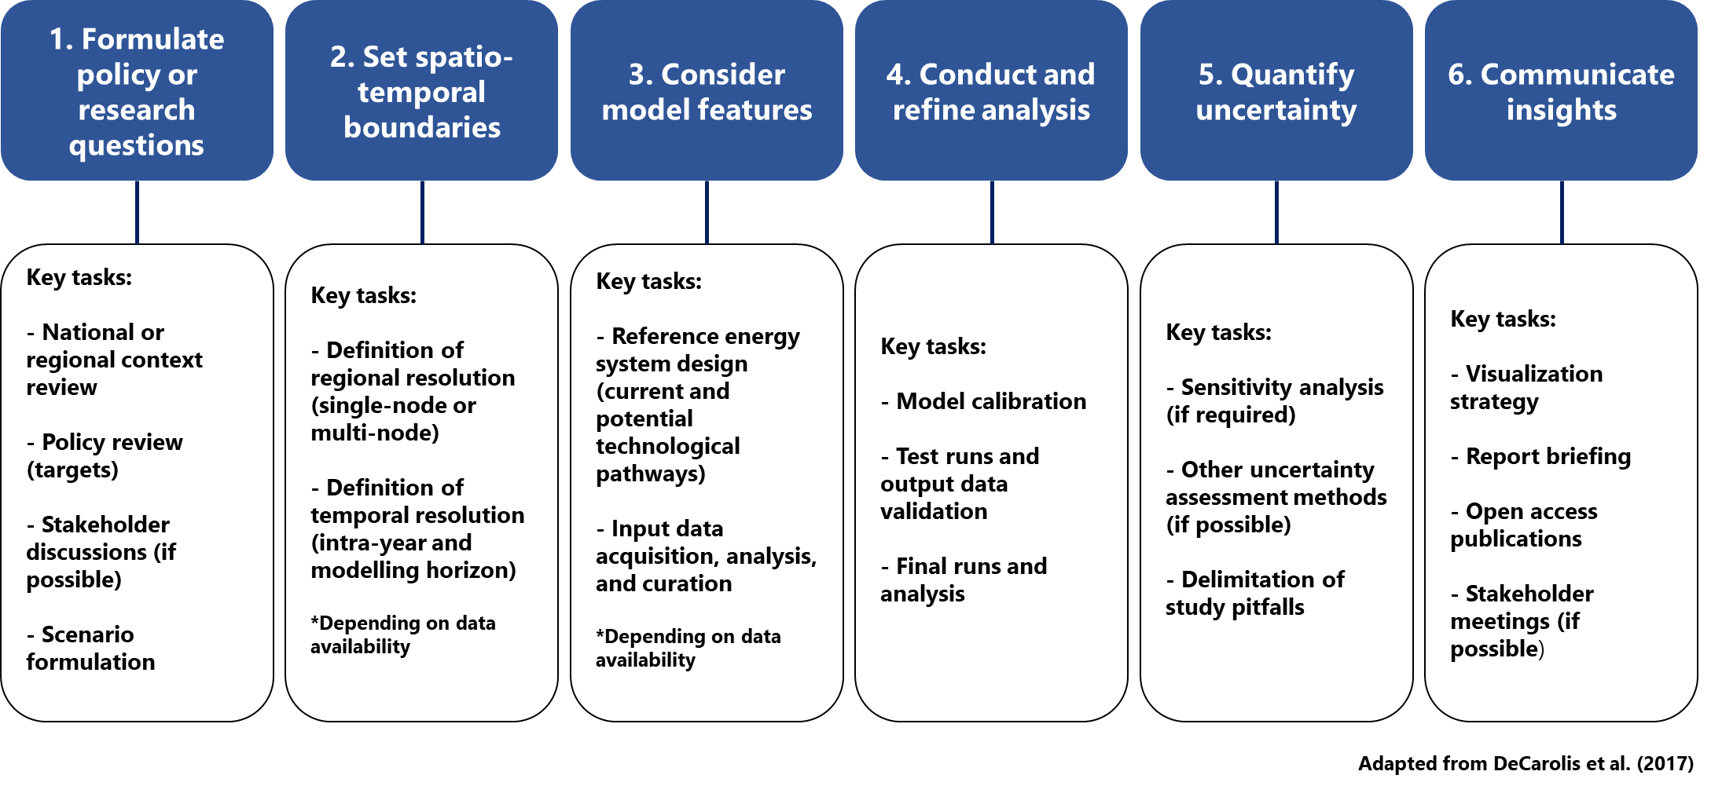
1.3 Basic concepts in energy system modelling
1.3.2 Energy system modelling pipeline
Source: Adapted from (DeCarolis et al., 2017)
16
Notes:
This figure presents the energy system modeling pipeline, illustrating the key steps involved in conducting a comprehensive energy system analysis. The process typically involves the following stages:
Formulate policy or research questions: The first step involves defining the goals and objectives of the analysis. This may include identifying specific policy questions or research objectives, such as investigating renewable energy integration, reducing emissions, or improving energy security.
Set spatio-temporal boundaries: After defining the research questions, the next step is to set the geographical (spatial) and time (temporal) scope of the model. This includes selecting the region(s) or country(ies) to be studied, as well as the timeframe (i.e., intra-year division and number of years).
Consider model features: At this stage, the necessary features and elements of the model are determined. This includes specifying what technologies, energy sources, and sectors (e.g., electricity, transportation) will be modeled, as well as the level of detail required to answer the research questions.
Conduct and refine analysis: This step involves running simulations or optimizations based on the data and model setup. Analysts may refine the model and perform multiple iterations to improve accuracy and ensure that the results are robust and meaningful.
Quantify uncertainty: Since future energy scenarios are inherently uncertain, this step involves quantifying the uncertainty of model outputs. Sensitivity analyses and probabilistic approaches are often used to account for variations in assumptions, such as fuel prices, demand growth, and technology costs.
Communicate insights: Finally, the results of the analysis are communicated to decision-makers, stakeholders, or the broader public. This involves translating complex model outputs into actionable insights, policy recommendations, or other forms of guidance to support informed decision-making.

Slide 17
1.3 Basic concepts in energy system modelling
1.3.2 Outcomes of an energy system model
What types of generation technologies are needed?
What should be the capacity of the new generation technologies?
What locations should the technologies be installed?
When should the technologies be invested in?
Source: (Tovar-Facio et al., 2021)
17
Notes:
This figure illustrates four fundamental decision areas that energy system models can inform, particularly when evaluating investments in new energy infrastructure. It is important to note that energy system models encompass a broader range of technologies —including heating, transport, and industrial energy use and are not just focused on power production (e.g. power plants).
1. What types of generation technologies are needed? Models help identify the optimal mix of energy supply technologies—whether electricity, heat, fuels, or other vectors—based on criteria such as cost, resource potential, emissions, and system integration needs.
2. What should be the capacity of the new generation technologies? Capacity decisions are guided by projected demand, technology constraints, and system-level optimization, supporting efficient and reliable energy service delivery across sectors.
3. What locations should the technologies be installed? Spatial considerations are central to planning. GIS-based models can determine where technologies should be deployed by analysing resource availability, infrastructure, land use, and proximity to demand centres. (Note: This applies particularly to spatially explicit or GIS-based energy models.) 4. When should the technologies be invested in? Temporal planning ensures that technologies are deployed in alignment with evolving demand, policy targets (e.g., emissions reductions), and technology readiness. Timing is also crucial for optimizing system costs and operation.
Disclaimer: While these are key outcomes, they are not the only ones, comprehensive energy system models can also provide insights into emissions pathways, operational strategies, policy implications, long-term investment needs and much more.

Slide 18
1.3 Basic concepts in energy system modelling
1.3.4 U4RIA Goals
U4RIA extends best practice and advances in transparency through a set of guidelines:
Ubuntu – modelling should engage communities.
Retrievability – should be easy to find and access data.
Reusability – should be re-usable.
Repeatability - should be repeatable and user friendly.
Reconstructability – should include instructions for how to rebuilt the energy modelling elements.
Interoperability – should allow for scenarios to be tested by other models or approaches and their compatibility to sub-sector or broader integration.
Auditability – should provide direct accountability to the funder of the energy modelling for policy support, as well as to society more broadly.
18
Notes:
Energy modelling for energy policy presents several challenges including opaque analysis, lack of community co-operation with socio-economic actors, and inappropriate answerability. To mitigate these issues, the following governance principles are proposed:
Ubuntu: This is a concept borrowed from African philosophy regarding our shared humanity. Here this refers to the fact that communities should be involved with energy modelling.
Retrievability: It is often the case that it is difficult to find data. However, it should be the case that data are easily accessed and found.
Reusability: The model should be re-usable, no matter the amount of times the model is licensed.
Repeatability: The model should be repeatable and user friendly in a digital workflow.
Reconstructability: This extends the concept of repeatability to include the instructions for how to rebuild the energy modelling elements. For example, input data, model relations, and resulting scenarios.
Interoperability: This allows for scenarios to be tested by other models or approaches and integrate with other sub-sectors and more broadly in general.
Auditability: This means that there should be direct accountability to the internal or external funders of the energy modelling for policy support, as well as to society more broadly.

Slide 19
1.3 Basic concepts in energy system modelling
1.3.5 State of the art example – Costa Rica
Costa Rica have a Nationally Determined Contribution (NDC) target compatible with a 2°C pathway.
To develop a National Decarbonisation Plan (NDP) the Costa Rican government acknowledged that a framework requires both qualitative and quantitative methods.
Steps taken:
Engage stakeholders with government, private sector, academia, and society.
Workshops: business-as-usual (BAU) and deep-decarbonization scenario.
Scenarios built with the OSeMOSYS model.
Results reviewed by the stakeholders in a back-casting participatory process
Led to an NDP
This work introduced a framework that can guide national energy policy in line with U4RIA governing principles.
19
Notes:
We will now look at a brief example of how the U4RIA principles can be applied.
Costa Rica have a Nationally Determined Contribution or N. D. C. target compatible with a two degree pathway.
To aid in the development of the national decarbonisation plan or N. D. P., the Costa Rican government acknowledged that a framework required both qualitative and quantitative methods. The first step undertaken was to engage stakeholders with high-level government actors, such as the president and ministers, and with the private sector, academia, and wider society. The second step was a series of workshops, where two scenarios emerged: a business-as-usual and a deep-decarbonization scenario. These scenarios where then built with the OSeMOSYS model. The results were reviewed by the stakeholders in a back-casting participatory process, which led to a final N. D. P.
The work introduced a framework that can guide national energy policy in line with the U4RIA governing principles.
Specifically, the stakeholder engagement involved the community (i.e. ubuntu) and the OSeMOSYS data and model code are published openly on GitHub for retrievability, reusability, and repeatability.

Slide 20
Lecture 1.3 References
DeCarolis, J., Daly, H., Dodds, P., Keppo, I., Li, F., McDowall, W., Pye, S., Strachan, N., Trutnevyte, E., Usher, W., Winning, M., Yeh, S., & Zeyringer, M. (2017). Formalizing best practice for energy system optimization modelling. Applied Energy, 194, 184–198 https://doi.org/10.1016/j.apenergy.2017.03.001
Howells, M., Quiros-Tortos, J., Morrison, R., Rogner, H., Blyth, W., Godínez, G., Victor, L. F., Angulo, J., Bock, F., Ramos, E., Gardumi, F., Hülk, L., Institut, R. L., & Peteves, E. (2021). Energy system analytics and good governance-U4RIA goals of Energy Modelling for Policy Support. https://doi.org/10.21203/rs.3.rs-311311/v1
Pfenninger, S., Hawkes, A., & Keirstead, J. (2014). Energy systems modeling for twenty-first century energy challenges. Renewable and Sustainable Energy Reviews, 33, 74–86. https://doi.org/10.1016/j.rser.2014.02.003
Tovar-Facio, J., Martín, M., & Ponce-Ortega, J. M. (2021). Sustainable energy transition: modeling and optimization. Current Opinion in Chemical Engineering, 31. https://doi.org/10.1016/j.coche.2020.100661
20

Slide 21
1.4 Outline of the course
1.4.1 Course Focus
This course will introduce energy system modelling and its use to support policymaking. The course will focus on OSeMOSYS.
OSeMOSYS
Open Source energy Modelling System
Capacity expansion planning
21
Notes:
So far in this lecture, we have discussed the importance of energy planning for sustainable development and the role that energy modeling can play in supporting policymaking. This course focuses on the concepts of energy system modeling and how they can be integrated into the policy process. We will start by introducing energy modeling tools and their applications. From Lectures 3 to 14, the course will focus on exploring how OSeMOSYS models are developed and covering key theoretical concepts in capacity expansion planning. Additionally, the course includes hands-on exercises where you will learn to develop your own models and analyses and explore how these skills can be applied to country-specific analyses to support future policymaking.

Slide 22
1.4 Outline of the course
1.4.2 OSeMOSYS Learning Outcomes
Aims of the course:
Gain an understanding of the main energy conversion processes in terms of resource needs, costs, performance, and environmental impacts
Analyse how alternative energy system configurations relate to sustainability and interact with the Sustainable Development Goals and energy security
Learn how to develop an OSeMOSYS model and alternative scenarios, working through examples
22
Notes:
In this course, you will gain an understanding of the key processes in energy systems. We will analyse these processes with respect to their performance, costs, resource needs, and environmental impacts, viewing them as part of the whole energy system. This knowledge will be applied to explore how different configurations of the energy system impact climate change mitigation and the Sustainable Development Goals. In both the lectures and hands-on exercises, you will learn how to develop your own model using OSeMOSYS. This can act as a foundation for doing your own country-level analysis, and there will be a focus on how the knowledge gained in this course can be applied in future work and policymaking.

Slide 23
1.4 Outline of the course
1.4.3 Overview of OSeMOSYS
Salvage value
Annual activity
Capital costs
Total activity
Operational costs
Annual adequacy
Annual energy balance
New capacity
Total discounted costs
Time-slice adequacy
Time-slice energy balance
Total capacity
Objective
Costs
Storage
Capacity adequacy
Energy balance
Constraints
Emissions
Basic OSeMOSYS Implementation
(Adapted from Loffler et al. (2017), image, licensed under CC BY 4.0)
23
Notes:
OSeMOSYS stands for the Open Source energy Modelling System. OSeMOSYS is a linear optimization energy system model that minimizes total system costs while meeting energy demands under given constraints. It optimally allocates energy resources, technologies, and investments across time to support long-term energy planning and policy analysis.
OSeMOSYS stands out from many other modelling tools as it is completely open source, freely accessible, and transparent. This means that OSeMOSYS is widely used for training and capacity building. Additionally, it is possible to learn how to use OSeMOSYS in a relatively short timeframe, especially compared to less accessible modelling tools. Overall, these key features mean OSeMOSYS is well placed to be used in a range of settings, from developers to academics to policymakers. Since the system requires no upfront financial investment, it can be used by resource limited governments and institutions. OSeMOSYS is used to develop long-term analyses of the energy sector at a range of scales, including continent-, country- and regional-level studies. OSeMOSYS has been used for a wealth of applications, from assessing electrification pathways to understanding the environmental and economic implications of decarbonization scenarios. You will learn more about OSeMOSYS and its applications as you progress through this course.

Slide 24
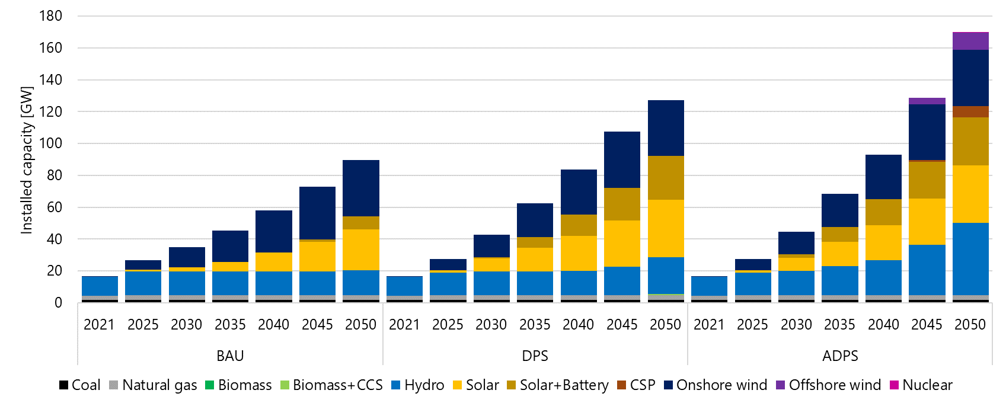
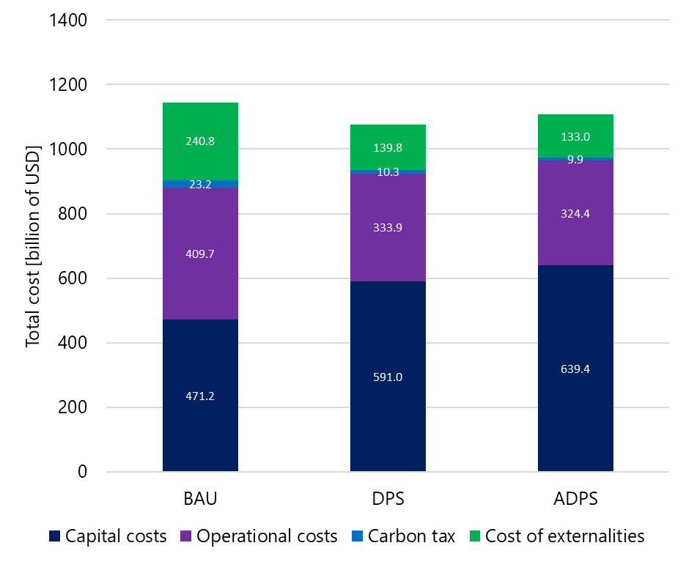
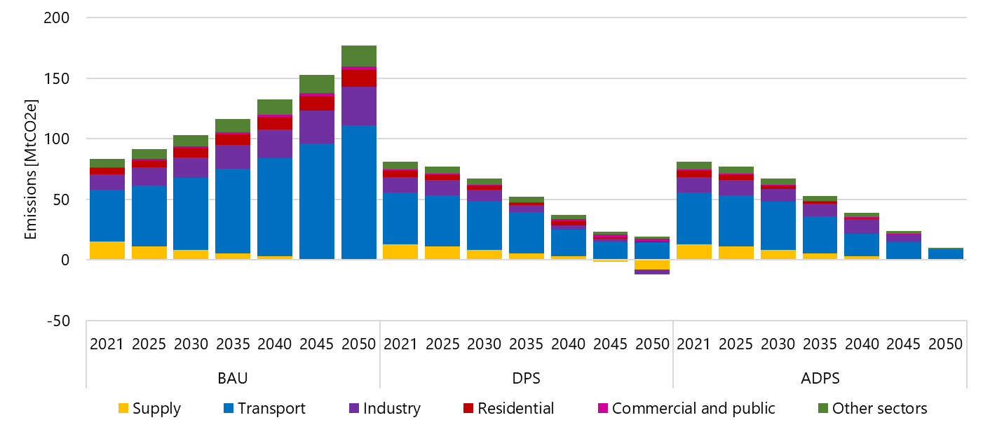
1.4 Outline of the course
1.4.3 Key outcomes of OSeMOSYS
Capacity expansion
Cost analysis
Emissions trajectory
Source: (Plazas-Niño et al., 2023)
24
Notes:
The figure presents some examples of key outcomes using OSeMOSYS modelling for long-term energy planning. Capacity expansion analysis is one of the primary results, helping to determine the optimal mix and scale of energy generation technologies needed to meet future energy demands. This includes specifying when and where new power plants should be built, ensuring that the system can reliably meet energy needs over time. Additionally, emission trajectory offers insight into the environmental impact of different energy pathways, tracking greenhouse gas emissions across scenarios and identifying the most sustainable options for decarbonizing the energy sector. Lastly, cost analysis delivers a comprehensive evaluation of the total costs associated with different energy strategies, including capital investments, operational expenses, and fuel costs, allowing decision-makers to weigh trade-offs between affordability, sustainability, and energy security.

Slide 25
Lecture 1.4 References
Löffler, K.; Hainsch, K.; Burandt, T.; Oei, P.-Y.; Kemfert, C.; Von Hirschhausen, C. Designing a Model for the Global Energy System—GENeSYS-MOD: An Application of the Open-Source Energy Modeling System (OSeMOSYS). Energies 2017, 10, 1468. https://doi.org/10.3390/en10101468
Plazas-Niño, F. A., Yeganyan, R., Cannone, C., Howells, M., & Quirós-Tortós, J. (2023). Informing sustainable energy policy in developing countries: An assessment of decarbonization pathways in Colombia using open energy system optimization modelling. Energy Strategy Reviews, 50, 101226. https://doi.org/10.1016/j.esr.2023.101226
25

Slide 26
Thank you
Consolidated by:
Fernando Plazas-Niño, Naomi Tan, Kane Alexander, Lucy Allington, Carla Cannone, Pooya Hoseinpoori, Alexander Kell, Adam Hawkes, Mark Howells
www.climatecompatiblegrowth.com

